Slide 1
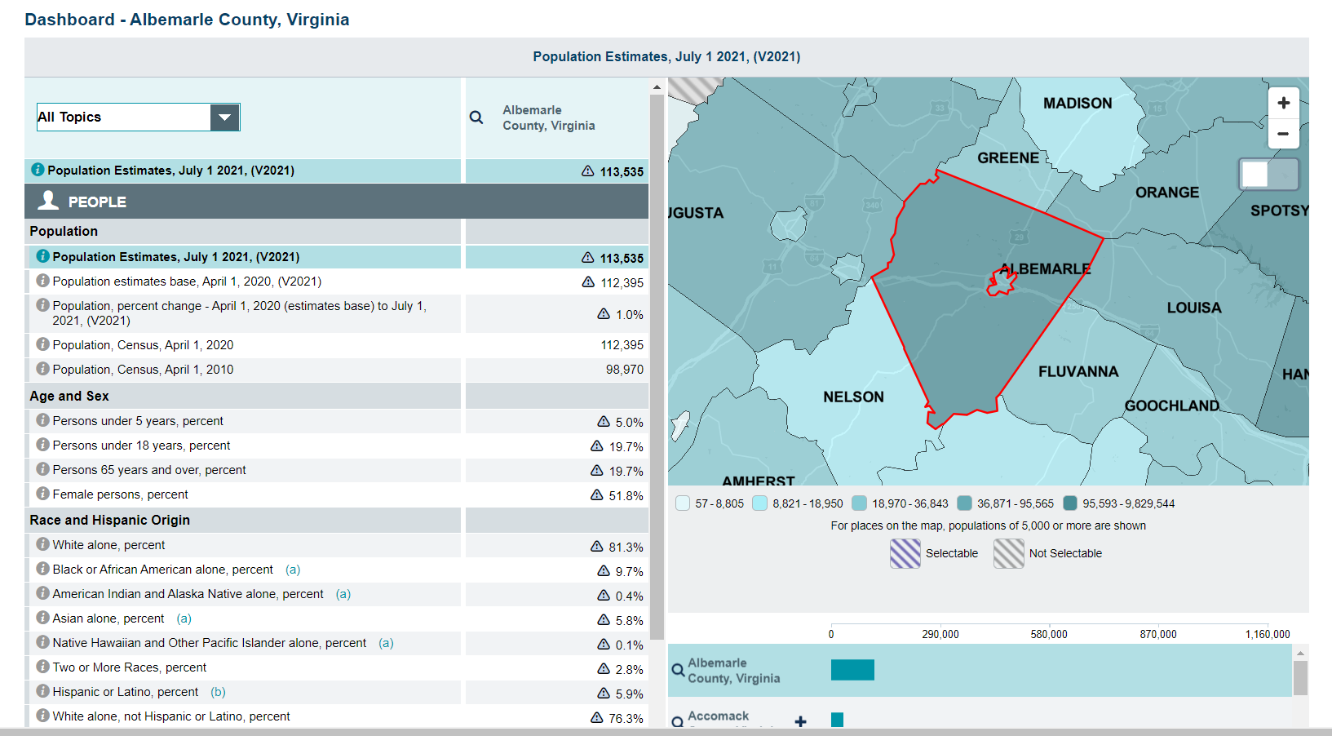

Slide 4
Side-by-Side Comparison

Slide 7
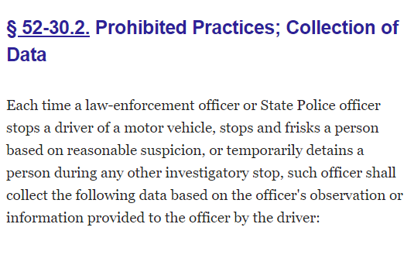

Slide 8
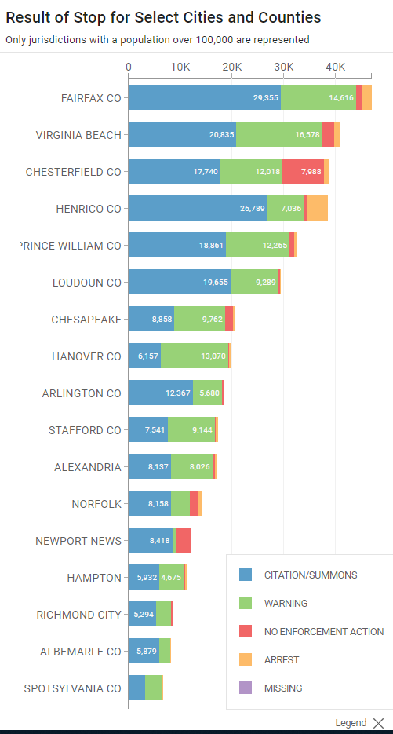
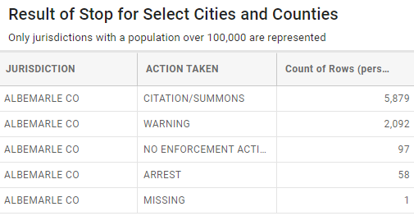
January 1, 2021 – December 31, 2021

Slide 9
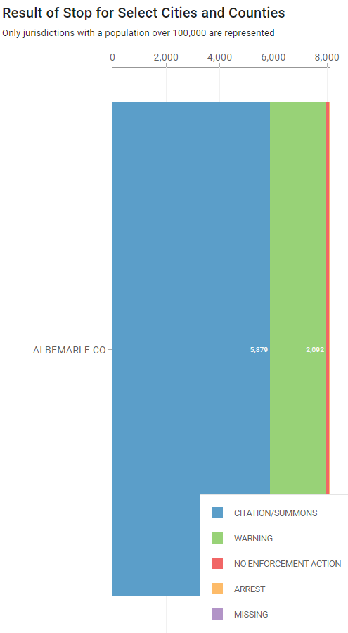
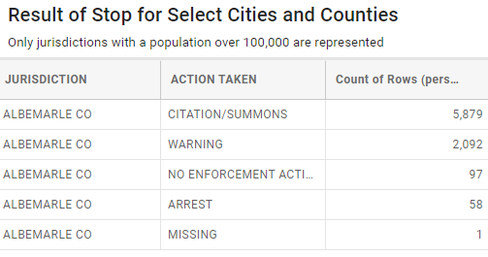
January 1, 2021 – December 31, 2021
Albemarle County

Slide 10
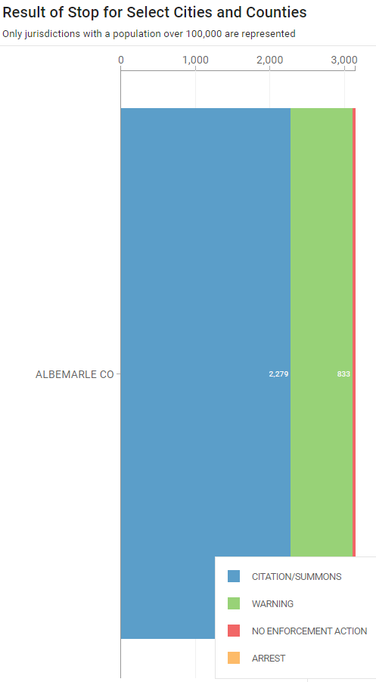
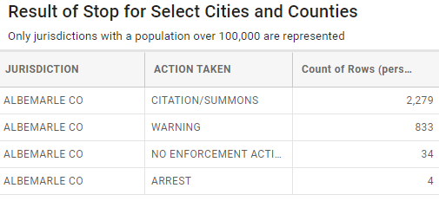
January 1, 2021 – December 31, 2021
Albemarle County Police Department

Slide 11
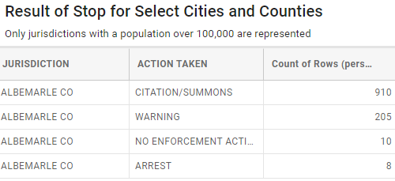
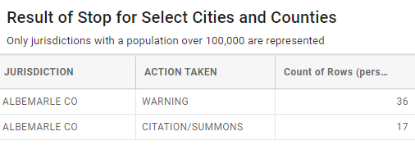
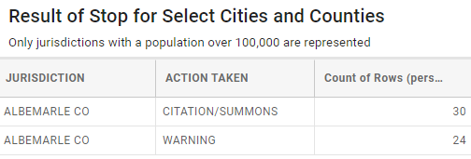
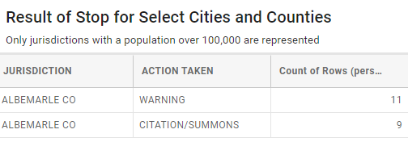
Virginia State Police
University of Virginia Police
January 1, 2021 – December 31, 2021
Town of Scottsville Police
Albemarle County Sheriff’s Office

Slide 12
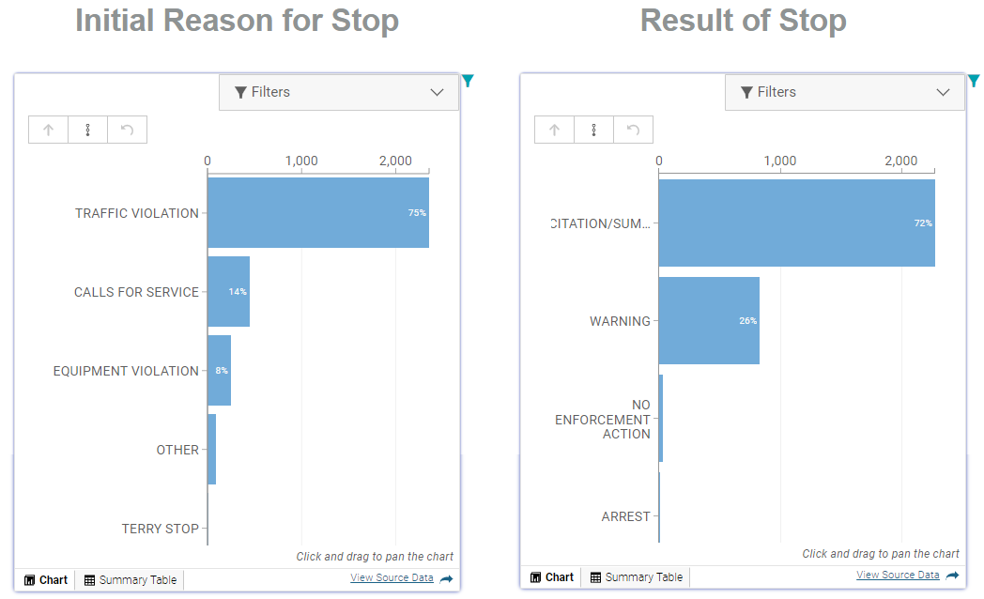

Slide 13
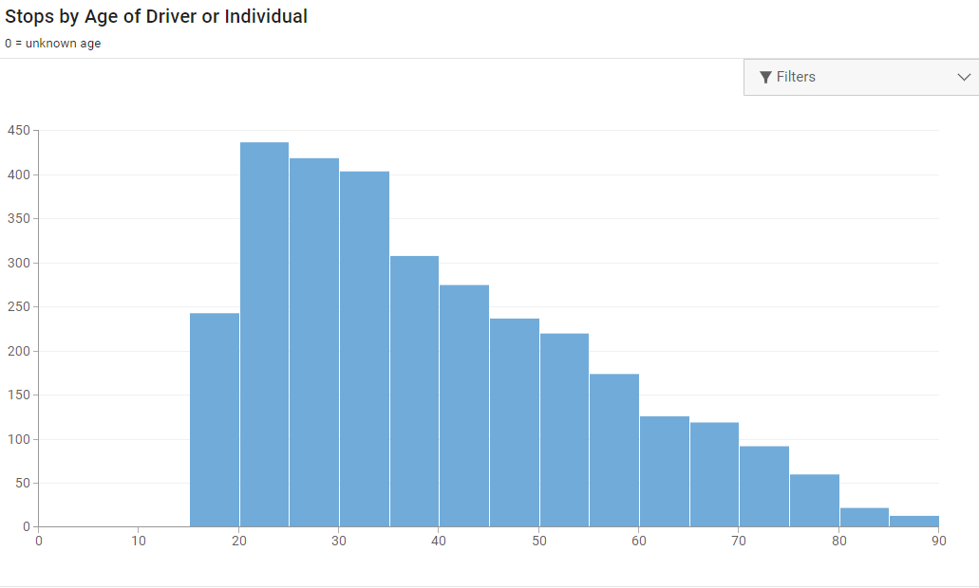

Slide 14
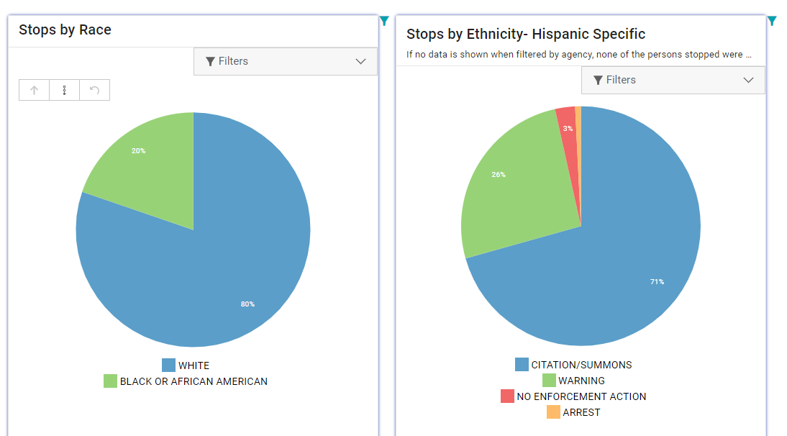

Slide 15
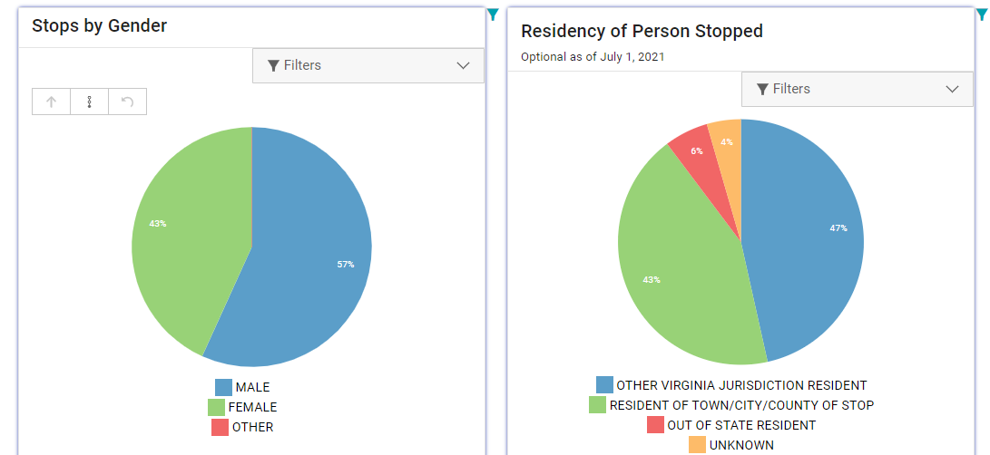

Slide 16
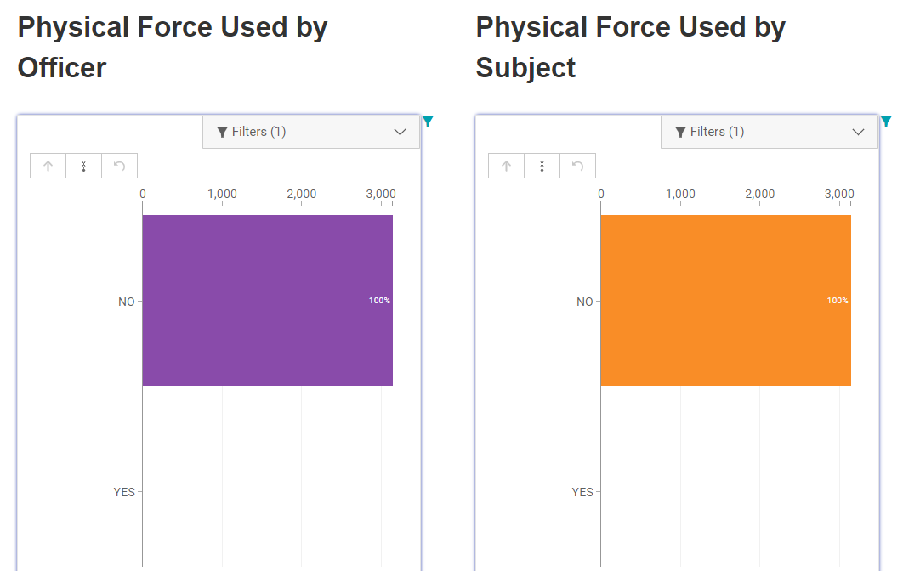

Slide 17
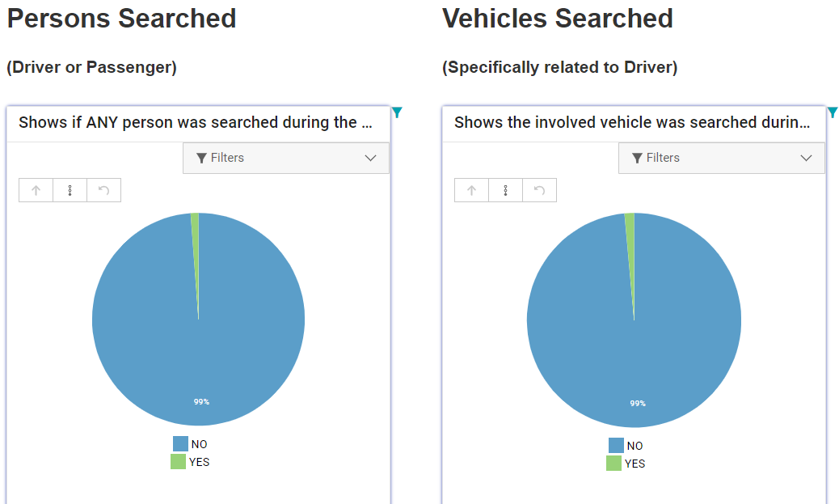

Slide 18
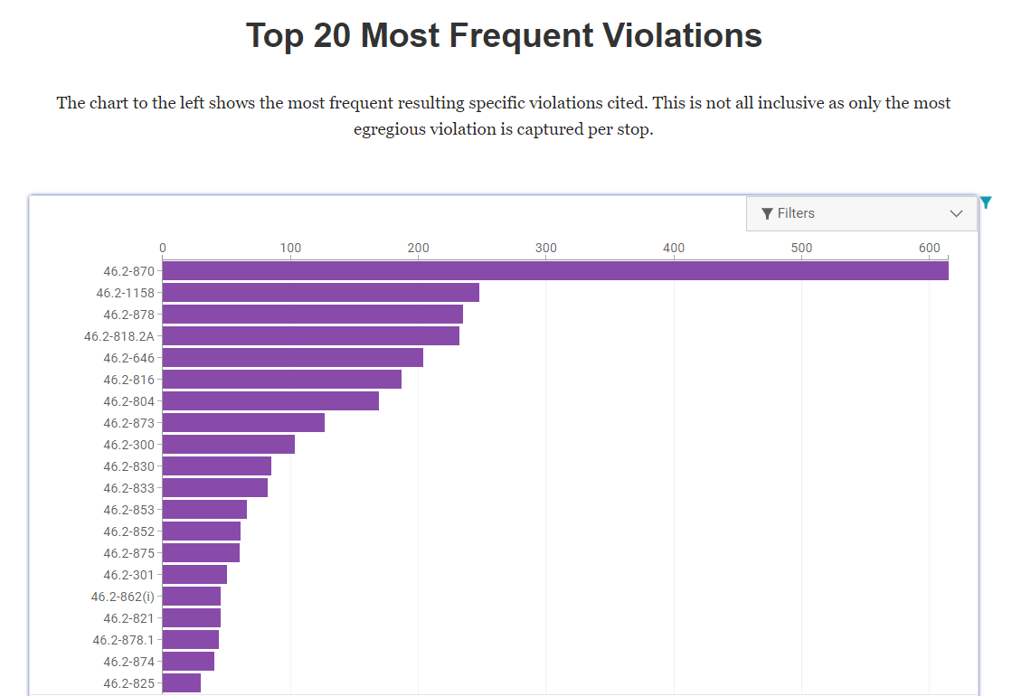

Slide 19
RACIAL PROFILING
2021
64,000 Encounters
34 Officer complaints
1 Allegation of Racial Profiling
2018 – 2021
14 Allegations of Racial Profiling

