Slide 1
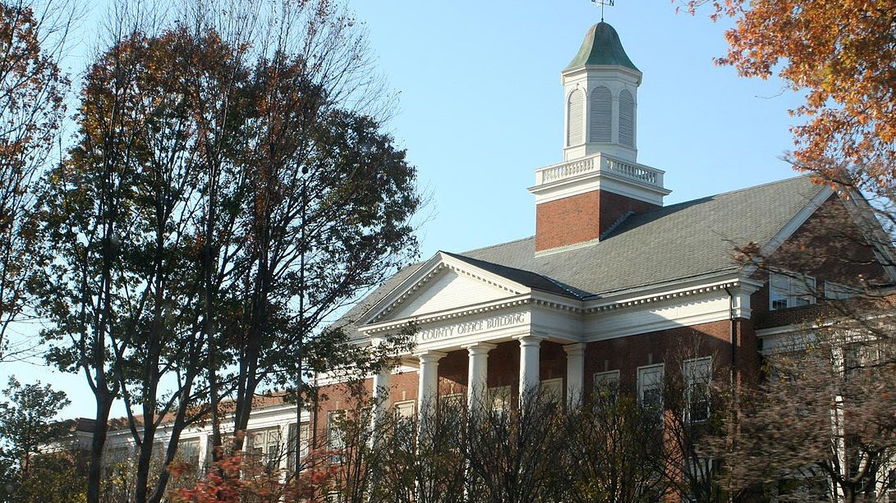
ACPD
Making a Difference in Our Community
Colonel Sean Reeves

Slide 2
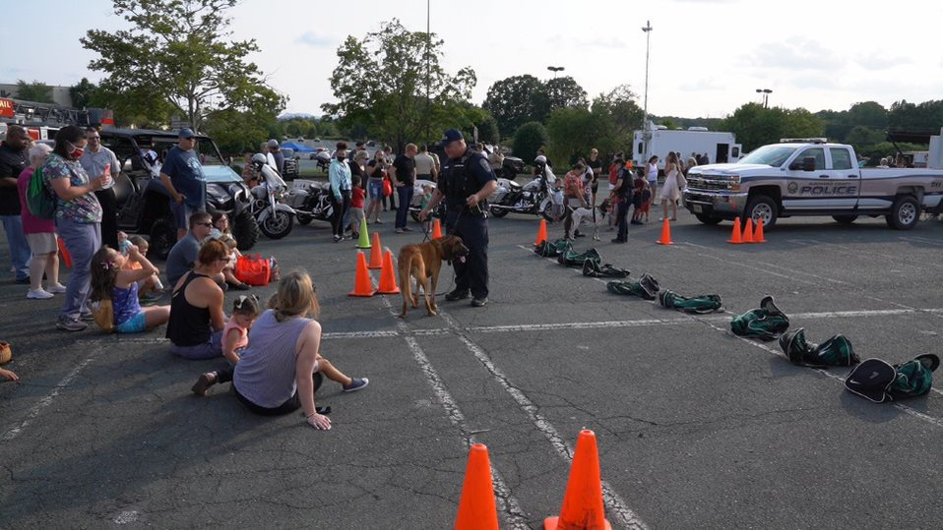
Our Mission
The Mission of the Albemarle County Police Department is to provide for the safety and security of all people, while protecting individual rights and building trust in our diverse communities through quality service.
Our Values
Community Integrity Innovation Learning Stewardship

Slide 3
March 1, 2022

Slide 4
ACPD Realignment
Chief of Police (Colonel)
Deputy Chief of Police (Major)
  Operations Bureau
    Patrol Division (Patrol Captain/Patrol Commander)
      Jefferson District (Lieutenant)
      Blue Ridge District (Lieutenant)
    Special Operations Division (Captain)
      SOD Deputy Commander (Lieutenant)
        Traffic (Sergeant)
          K-9
          Logistical Operations
        Animal Control (ACO Supervisor)
        Crisis Response Team (Sergeant)
Assistant Chief of Police (Major)
  Administrative Bureau (Re-Brand)
    Criminal Investigations Division (Captain)
      Evidence
      Victim Witness
    Professional Standards Division (Captain)
      Training (Lieutenant)
      IA (Lieutenant)
      Accountability & Audits (Sergeant)
      FOIA (Civilian)
      PIO (Civilian)
    Administrative Services Division (Civilian)
    Merging of First Sergeant and Sergeant Ranks

Slide 6


Slide 7
Workforce Stabilization
Recruit Competitively
  Within the Region
  Attract New and Certified Officers
  Maintain Hiring Standards
  Our Goal- Starting Salary at or above 50K
    UPD $53K +6K Bonus
    GOOCHLAND $53K
    LOUISA $51K
    LYNCHBURG $50K
    CPD $50K +5K Bonus
    GREENE $46.5K
    FLUVANNA $47.5K +5K Bonus
    ALBEMARLE $46K +3K Bonus
    AUGUSTA $46K
    LAKE $45K +3K Bonus
Retention

Slide 8
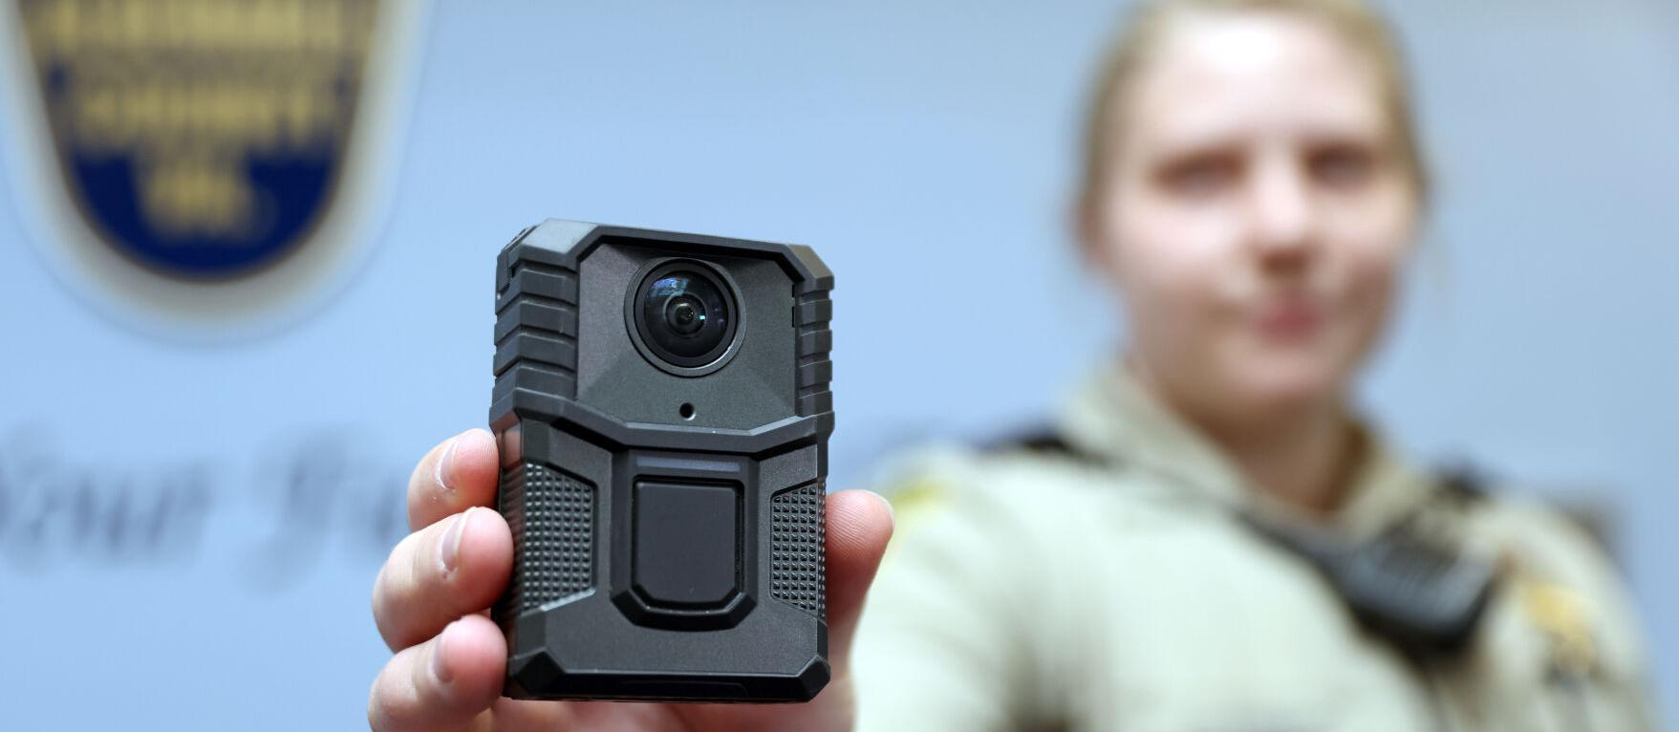

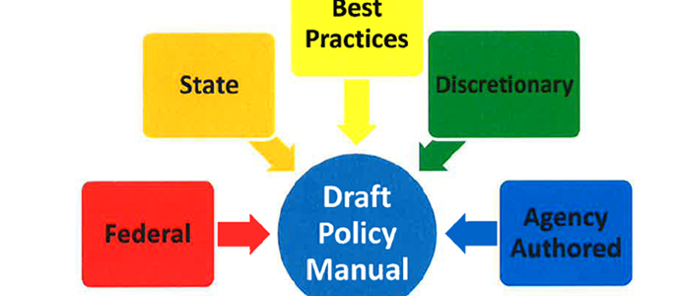
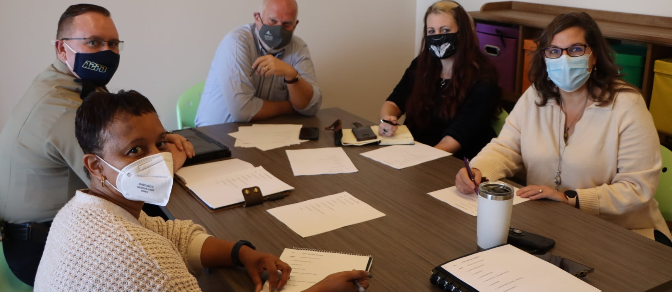
2022 New Initiatives
Body Worn Camera Implementation
Policy Overhaul (Lexipol)
Crisis Intervention Team Assessment Center (CITAC)
Mental Health/Crisis Response Team
Establishment of DEI Peer Support Team
Virtual Reality Training Simulator
Independent Evidence Unit Audit
Exploration of Drone Usage
Exploration of Speed Cameras in School Zones
Active Shooter/Threat Group (ACFR, ACPS, CEX)
Monthly ACPD Community Newsletter
Continued Community Engagement
Enhanced Employee Engagement by Command Staff

Slide 9
Questions

