Slide 2
One in five.
Fastest growing segment
Notes:
WHY NOW? By 2030, one in five people in our region will be 65 or older.

Slide 3
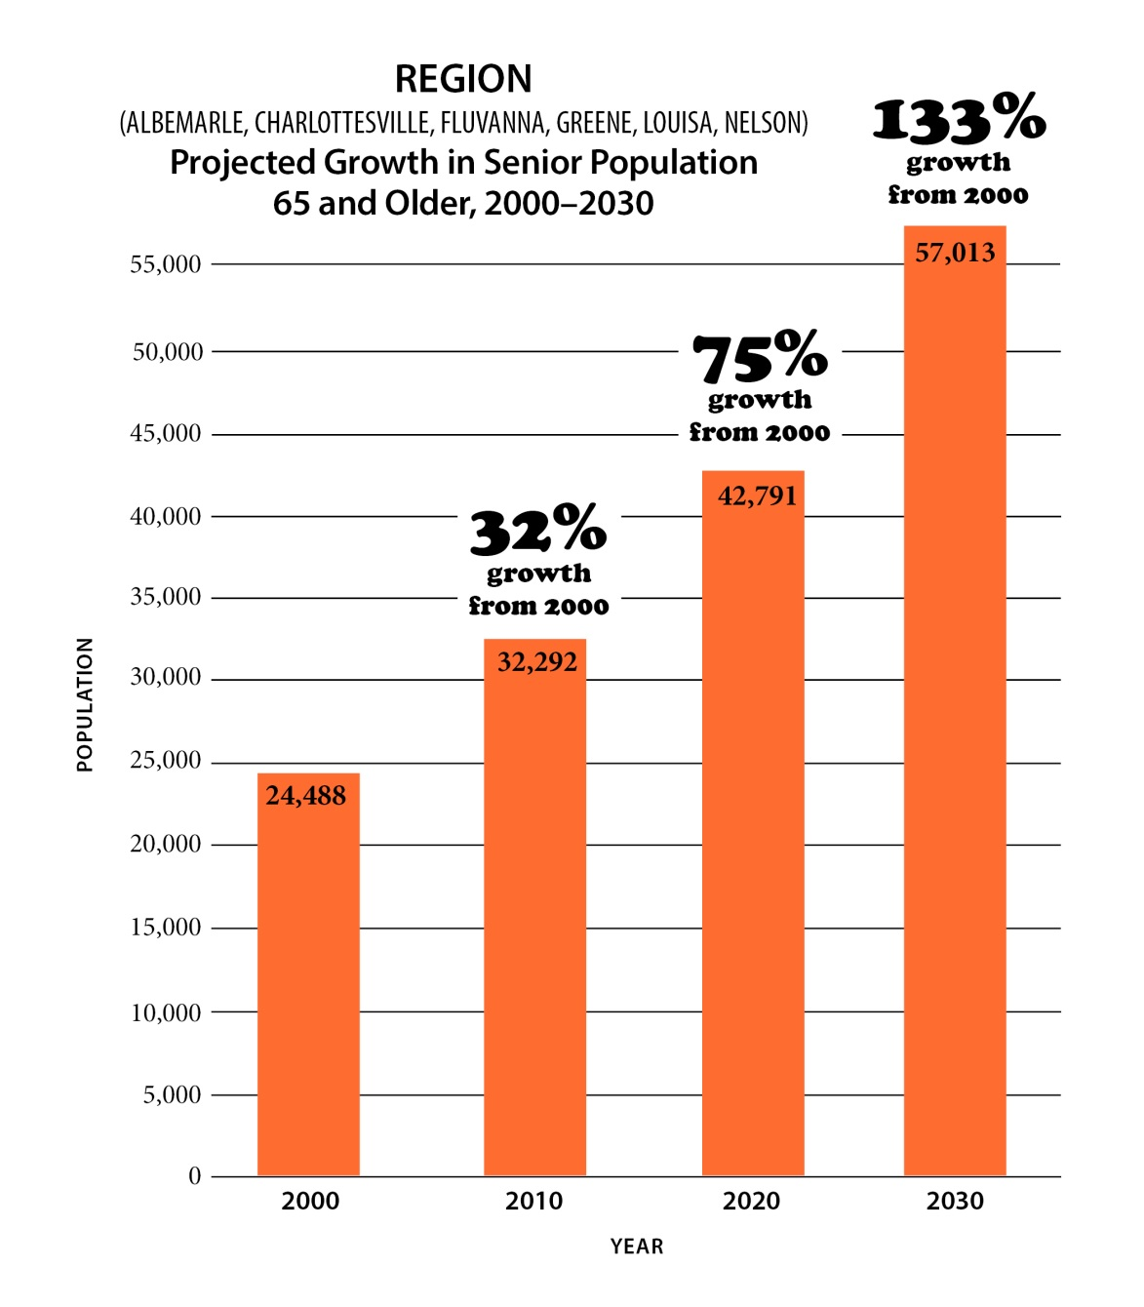
Demographics

Slide 4
2020 Demographics Update
42,791 residents over age 65 projected for 2020.
Actual 2020 Census:
48,337
5,546 more than projected or 11.5%
Albemarle County 22,254 or 19.8%
City of Charlottesville 5,586 or 12%
Fluvanna County 5,423 or 19.9%
Greene County 3,679 or 17.9%
Louisa County 7,406 or 19.7%
Nelson County 3,989 or 27%

Slide 5
More statistics on over 65
22% live alone
9% live in poverty
11.% live with Alzheimers/ dementia
14% need regular care to remain in their homes
11% of food bank recipients
9% diabetes/ 24% hypertension

Slide 6
greater Charlottesville area to be the most age-friendly community in the country
vision
lead the advancement of an age-friendly community
mission
Notes:
Formation of the Charlottesville Area Alliance

Slide 7
Organizational Structure
Partners: Advocates, leaders, stakeholders serving or advising the senior population.
AHIP, Albemarle County, Alzheimer’s Association, City of Charlottesville, Cville Village, Fluvanna County, Hospice of the Piedmont, Home Instead, JABA, JAUNT, Legal Aid Justice, OLLI, PHA, Region 10, Senior Center, Sentara MJH, TJ Health District, TJPDC, United Way, UVA Health System, Westminster-Canterbury Blue Ridge
Notes:
21 Partner organizations and growing

Slide 8
What does age-friendly mean?
AGE-FRIENDLY = GOOD FOR EVERYONE
Plan for the needs of an aging population and we automatically check off the needs of all constituents.
“Winning communities in the future will be the ones that invest in creating great places to live, work, learn, and play at every age. Charlottesville Area Alliance is the right idea at the right time.”
Matt Thornhill
Founder & President, Boomer Project & GenerationsMatter
Notes:
WHO's Age-Friendly Cities and Communities Program is an international effort launched in 2006 to help cities prepare for rapid population aging and the parallel trend of urbanization. AARP Network of Age-Friendly Communities is an affiliate. An age-friendly community is set up to help seniors live safely, enjoy good health, and stay involved. It retains and attracts seniors.

Slide 9
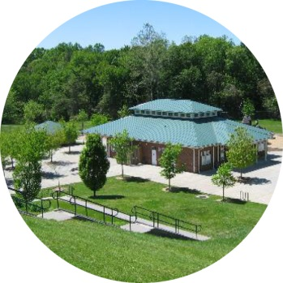
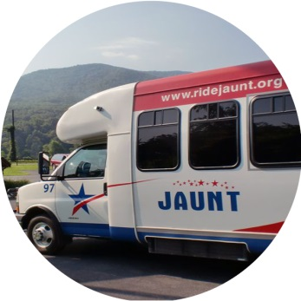
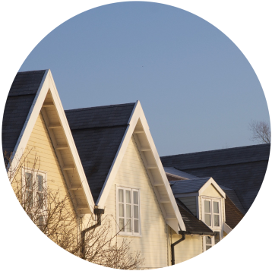
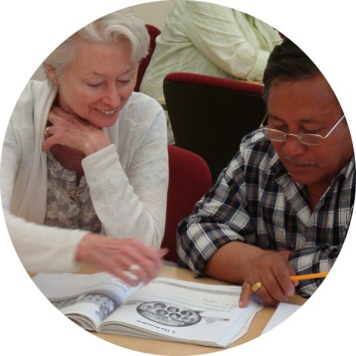
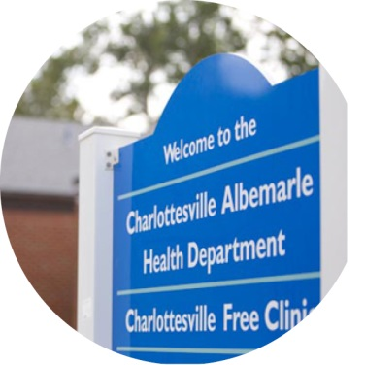
World Health Organization Indicators
8 LIFE ELEMENTS
FOR AN AGE-FRIENDLY COMMUNITY
Buildings & Outdoor Spaces
Housing
Transportation
Social Participation
Community Support & Health Services
Respect &
Social Inclusion
Civic Participation
& Employment
Communication & Information
Notes:
To measure impact, the CAA will utilize the World Health Organization’s measurement/indicators.

Slide 10
WHO/AARP Age-Friendly Network
World Health Organization identified aging as one of the most significant public health issues our globe faces.
SOCIAL ISOLATION is the foundational issue!
Developed age-friendly metrics in 2006
AARP joined as American partner in 2014
2017 Albemarle County, Fluvanna County and City of Charlottesville, with CAA leading the effort, were accepted into the WHO/AARP network.
2018-19 CAA conducted a survey, in conjunction with the Health Dept, a specific seniors survey, and focus groups to identify the elements perceived as requiring focus, and their priorities. Top two for us: Transportation and Social Isolation/Engagement
TJPDC approved CAA participation
Notes:
Well-designed, livable communities promote health and sustain economic growth, and they make for happier, healthier residents — of all ages.
Membership in the network is not an endorsement by AARP.

Slide 11
Support the process of becoming an age-friendly community!
Notes:
Support the process of becoming an age-friendly community through representation on the Alliance; through support of agencies that work with seniors; Albemarle and Charlottesville have already signed the AARP network to reflect this commitment.

