Slide 1
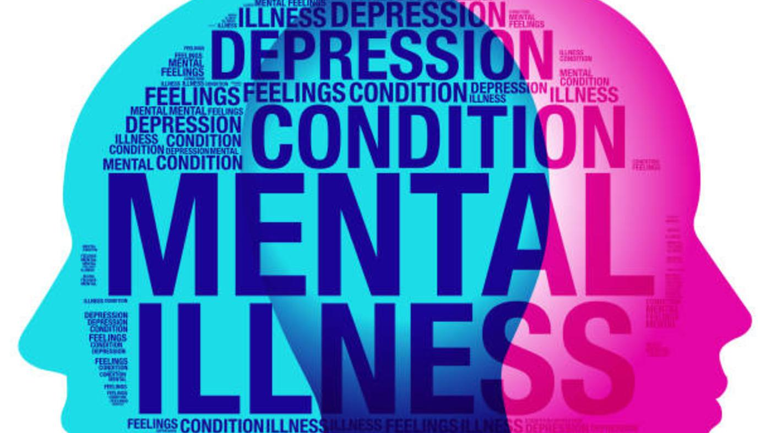
Response to Mental Health Crisis Calls in Albemarle County
February 9, 2021

Slide 2

Overview of Mental Health
Mental health is an important part of overall health and well-being. Mental health includes our emotional, psychological, and social well-being. It affects how we think, feel, and act. It also helps determine how we handle stress, relate to others, and make healthy choices. Mental health is important at every stage of life, from childhood and adolescence through adulthood.
About 1 in 5 American adults and 1 in 5 children will experience a mental illness at some point in their lives.
Suicide is the 2nd leading cause of death among people ages 15-34 in the United States.
Mental illness can be treated. Research shows that people with mental illness can get better and many recover completely.
The vast majority of people with mental illness are no more likely to be violent than anyone else. In fact, people with mental illnesses are more likely to be victims of violent crime than the general population.

Slide 3
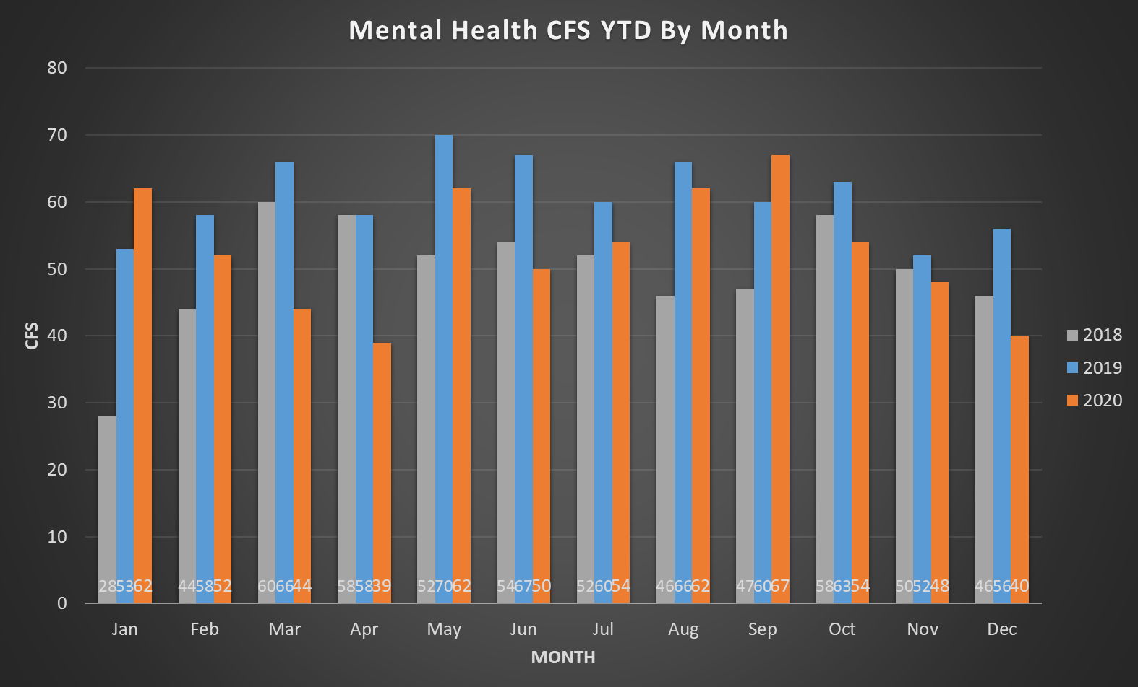

Slide 4
MENTAL HEALTH, CONTINUED
2020 mental health CFS were up 1% compared to the 3YAvg for the same time period.
Example: Total time spent in December to clear: 139:11:58
2020 suicides:
+46% from 2019
+73% from 2018
Notes:
Data pulled on 1/8/21
Time spent: ACPD incidents handled by at least one ACPD officer that were not cancelled and included a 931 disposition with at least one enroute time and at least one clear time (38 out of 40 CFS – 95% of 931 calls)
Suicide: Case crime code 954

Slide 5
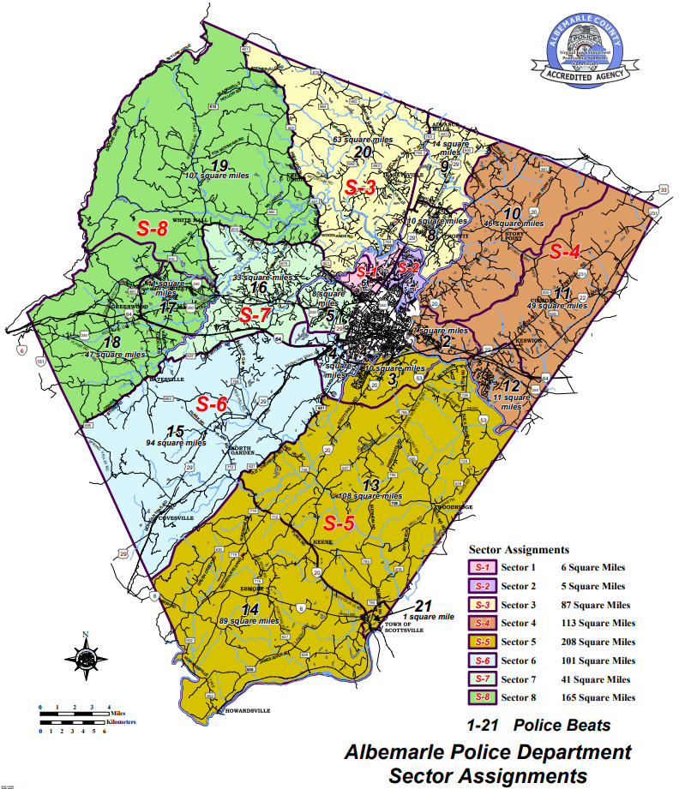

Slide 6
Mental Health Response Training

Slide 7
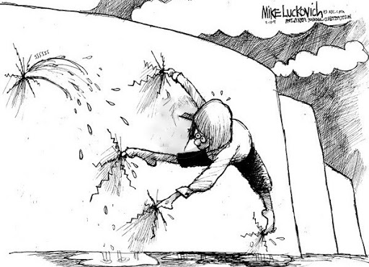
Overview of Current Process

Slide 8
Imprisoning America’s Mentally Ill
In 2018, the Bureau of Justice Statistics (BJS) reported that 14 percent of prisoners in state and federal facilities met the criteria for having serious mental health conditions. In local jails the number was 26 percent. Only five percent of the general population meets those criteria, according to the BJS. Mental illness also affects a higher percentage of female prisoners than males.
According to federal data, 40 percent of prisoners were diagnosed with a mental health disorder between 2011 and 2014. Every year two million people with psychological problems are jailed, based on estimates by the National Alliance on Mental Illness. A 2016 report by the Treatment Advocacy Center found that mentally ill prisoners stay locked up longer, cost more to house and are more likely to commit suicide and be placed in solitary confinement.
The costs of incarcerating the mentally ill are significant. In Michigan, where mental illness afflicts a quarter of the state’s 41,000 prisoners, it costs $95,000 a year to house each one, compared to $35,000 for prisoners without mental health problems. For the mentally ill who are not incarcerated, the state spends just $6,000 each per year, on average (Lyon, E, 2019).

Slide 10
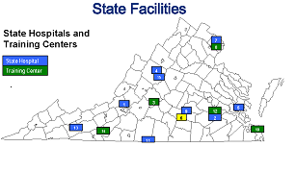
Virginia Department of Behavioral Health & Developmental Services
Virginia operates 9 facilities: eight behavioral health facilities for adults, one psychiatric facility for children and adolescents, and a center for behavioral rehabilitation.
Several of these facilities are operating at limited capacity due to COVID-19 restrictions.

Slide 11








Mental Health Crisis Response Team
“De-Criminalizing Medical Calls for Service”
Purpose:
Enhance and Stream-Line Services
Reduce Impact on Local Hospitals
Criminal Justice Reform
  - De-escalation
  - Alternatives to Court and Jail
  - Reduce Civil Liabilities
  - Legal Compliance

Slide 12
What Could Be

Slide 13
Marcus Alert
In November 2020, Governor Northam signed into law The ‘Marcus’ Alert, which will establish a statewide mental health awareness response. The measure also promotes a behavioral health response to individuals in crisis and limits the role of law enforcement.
The law is named after a 24-year-old man who was shot and killed by a Richmond police officer on May 14, 2018, while experiencing a mental health crisis.

Slide 14
TIMEFRAMES
July 1, 2021- A plan for a Marcus Alert system must be developed
  • Requires outline of DCJS and law enforcement agencies’ roles and engagement with the Marcus Alert System
  • Outline of DCJS’s role in the development of minimum standards., best practices and review and approval protocols for law enforcement participation
  • Plans for measuring progress towards the goals for law enforcement participation
• A voluntary database will be implemented and made available to 9-1-1 and Marcus Alert system to provide mental health and emergency contact information for response in an emergency or crisis
December 1, 2021- Five Marcus Alert programs and community care or mobile crisis teams
July 1, 2022- Every locality shall have established local protocols that meets requirements developed by DBHDS for:
• Diversion of certain 9-1-1 calls to crisis call centers
• Participation of law enforcement in the Marcus Alert system
July 1, 2023- Five additional Marcus Alert programs and community care or mobile crisis teams
• CSBs that serve the largest population in each region, unless previously selected, shall be selected for this phase of implementation
July 1, 2026- Statewide implementation of Marcus Alert programs and community care or mobile crisis teams must be complete

Slide 16
Albemarle County Mental Health Crisis Response
ECC Patch to Hotline
Crisis Call
Screening Process
Services Provided
1) Transported to Facility
2) Deferral to Social/Health Program
Crisis Response Team Dispatched
1) Mental Health Worker
2) Social Services
3) Rescue
Public Safety Risk
Law Enforcement Renders Situation Safe, Transfers Call to Response Team
Incident Resolved

Slide 17
Crisis Response Work Group
Albemarle Police- Major Sean Reeves
CIT- Tom Von Hemert
Albemarle Sheriff’s Office- Sheriff Chan Bryant
Social Services- Mary Stebbins
Region Ten- Lori Wood
County Legal- Amanda Farley
Fire Rescue- Deputy Chief David Puckett
Commonwealth’s Attorney (Mental Health docket)- Jim Hingeley
ECC- Sonny Saxton
To Be Included Later:
  Internal CIT Representatives
  Magistrate’s Office
  Alternative Transportation Services

Slide 18



Next Steps?
Awareness of mental health issues in our community
Support Region Ten partners
Support reform that decouples law enforcement from medical calls for service
Work group strategic planning
Explore the need for a Health and Human Services Department within Albemarle County

