Slide 1
Albemarle County Police Department

Slide 2
Albemarle county police department support services bureau

Slide 3
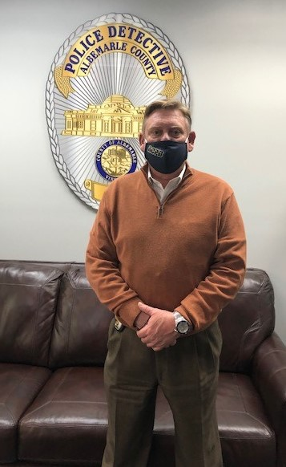
INVESTIGATIONS
Detectives
  Change in response to major cases
    Processing crime scenes, interviewing victims / witnesses / suspects
  Court response
    Limitations on who can attend preliminary hearings
    Number of officers restricted in court
  Investigating cases while working from home
  Coordinating with outside jurisdictions
Evidence Unit
  Staggering schedules
  Coordinating with Department of Forensic Science
FOIA
  Meeting deadlines while working from home

Slide 4
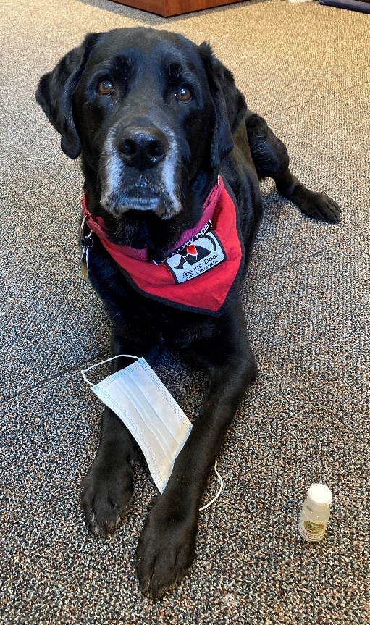
Victim / witness
Purchased hand sanitizer & masks to give to victims who had to come to court in person
Met with victims and CA’s Office via conference call, FaceTime, and Zoom to answer questions and prepare for court
Arranged for victims to appear by phone, WebEx, or FaceTime if there was concern about health condition or potential exposure
For Spanish speaking victims, translated the forms over the phone or texted the requested information in Spanish
Petitioning the court for protective orders
  J&DR Court and General District Court
Frequently left home to go to court and then return home
Staggering schedules; coordinating to help cover all cases
Training via Zoom

Slide 5
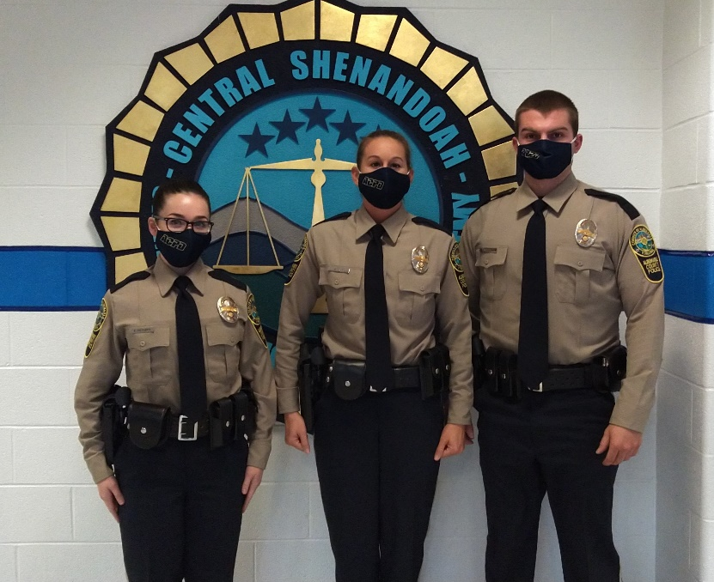
TRAINING & PROFESSIONAL DEVELOPMENT
All in person recruiting stopped
9 of the 11 application process steps required changes for compliance with COVID protocols and to ensure everybody’s safety
Numerous testing dates per month with very small groups
  Each event required decontamination prior and afterward
Worked with contractors to enable their services remotely or in alternate venues
Yearly requirements had to be done online or distance learning
Mini academy set up to complete post academy training
  Kept recruits isolated but active in their learning
Expanded hours / Teleworking / Staggered schedules
All officers completed required hours in record time
  Everyone recertified by December 1st

Slide 6
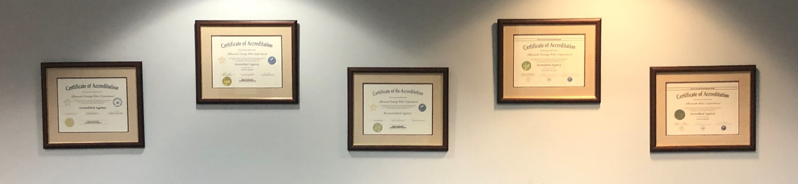
Support division
Successful State Reaccreditation
  Internal collaboration conducted virtually
  Official assessment postponed; made changes to ensure health and safety
PowerDMS Acquisition for Accreditation
  Preparation / communication / training conducted virtually
Timekeeper Implementation
  Teleworking; virtual meetings
Grant Funding
  Coronavirus Emergency Supplemental Funding grant; Byrne JAG grant; Vic/Wit Program grant
Successful DCJS Victim Witness Grant Audit
  Completed virtually / through phone conversations / submitting paperwork

Slide 7


Operations bureau

Slide 8
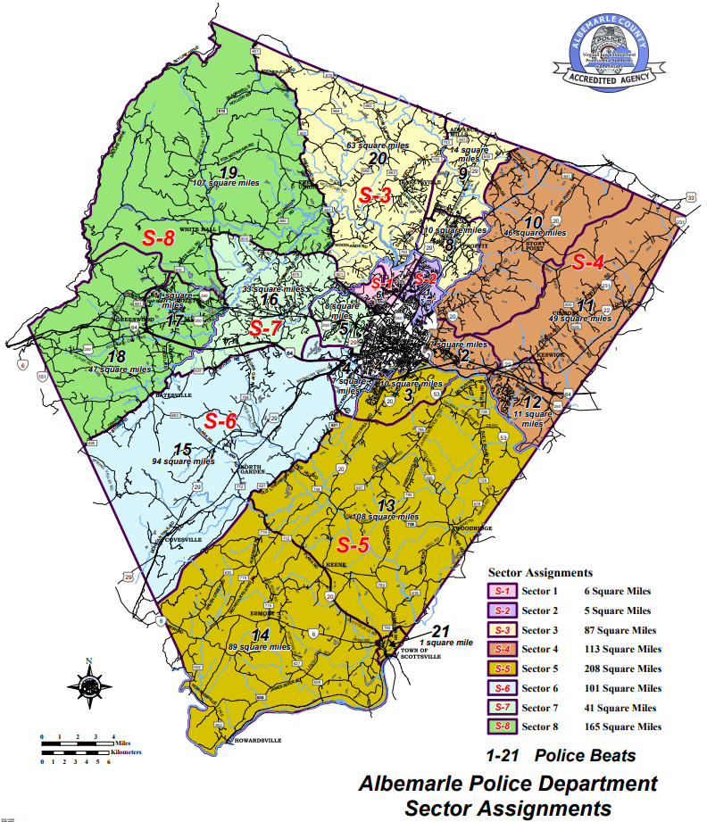

Slide 9
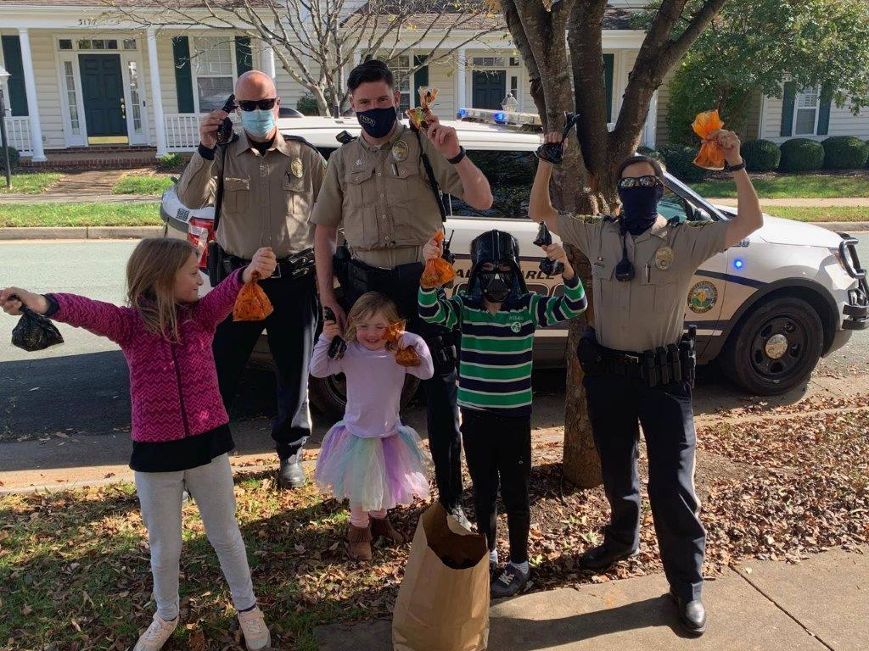
Operating during a pandemic
Representation on the COVID-19 IMT
Maintained continual 24/7 public safety operations
Public Safety Risk Mitigation Measures:
  Altered response to calls for service
  Transitioned to virtual roll-calls
  Reduced motor vehicle stops
  Changed our means of transporting arrestees
Governor’s Executive Orders:
  Education – Compliance - Enforcement

Slide 10
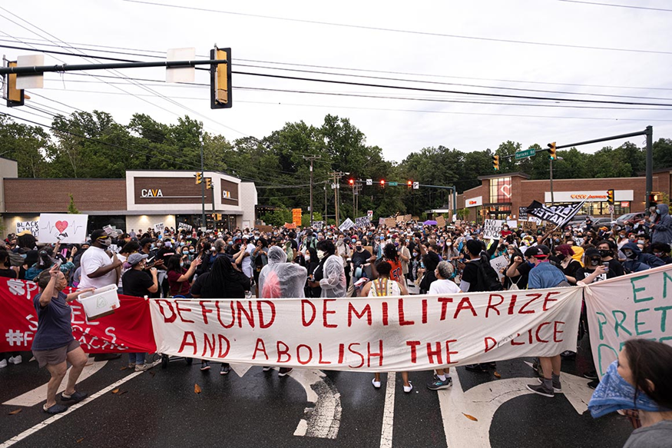
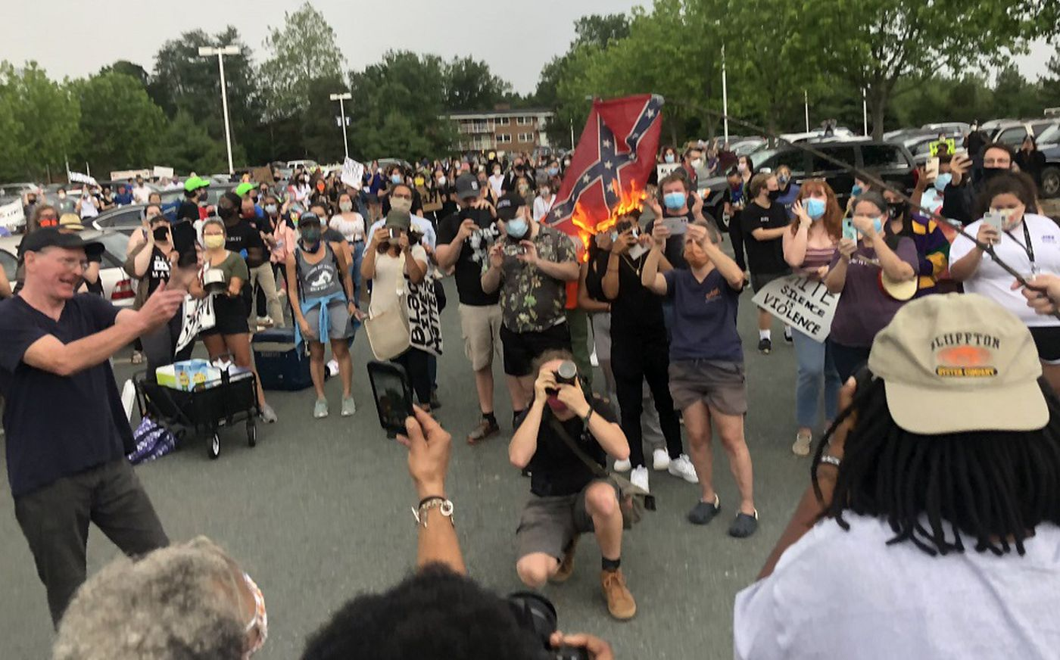
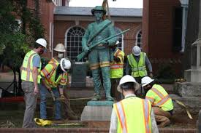

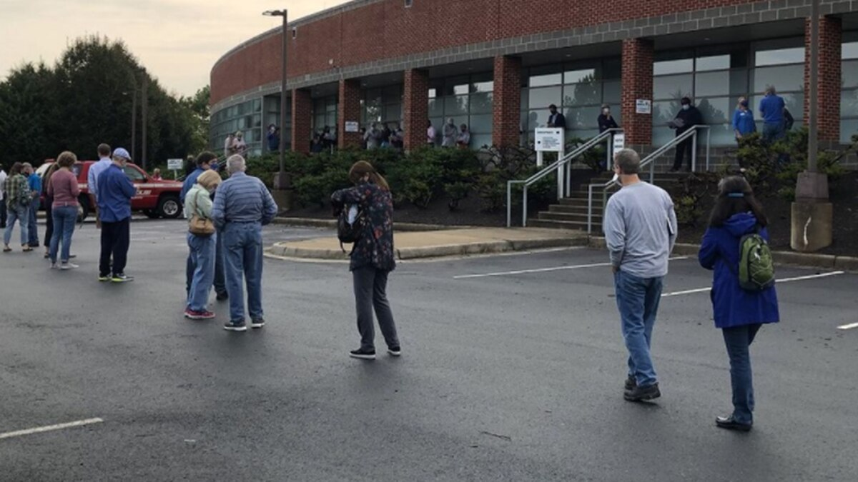

Slide 11


ACPD STATS: 2020
Crime & CFS Compared to the 3-Year Avg.
Suicides are up 27%
Domestic Incidents are up 21%
Orders of Protection are up 13%
Traffic Fatalities are up 34%
Proactive Patrols are up 22%
Public Generated CFS are down 9% (2-Yavg)
Traffic Stops are down 68%
Reportable Crashes are down 23%
Arrests are down 24%
No Change in Mental Health CFS

Slide 12
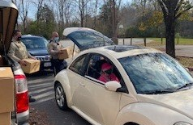
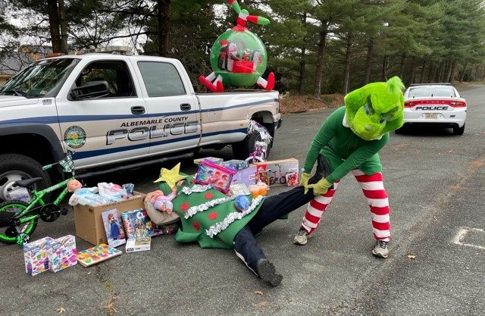
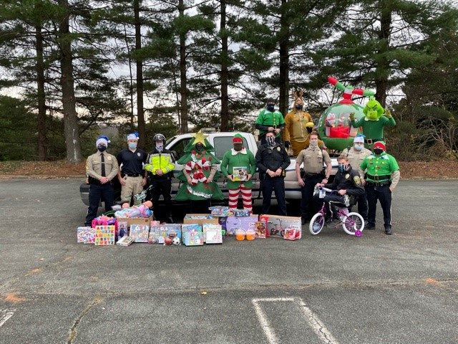
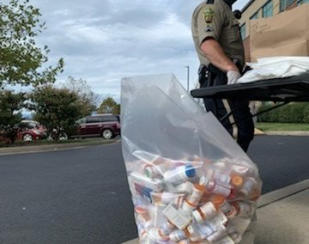
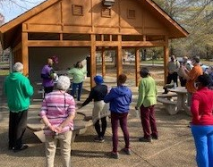

Slide 13
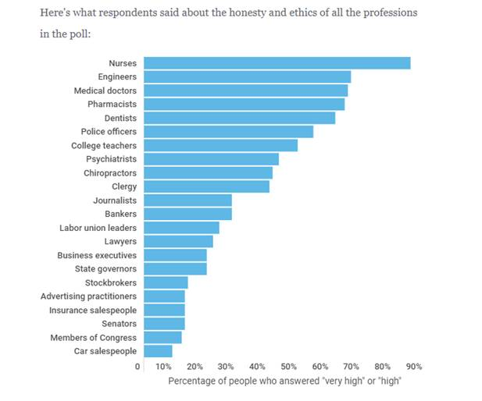
2020 Gallup poll ON Honesty and ethics:

Slide 14
Questions?

